Slide 1
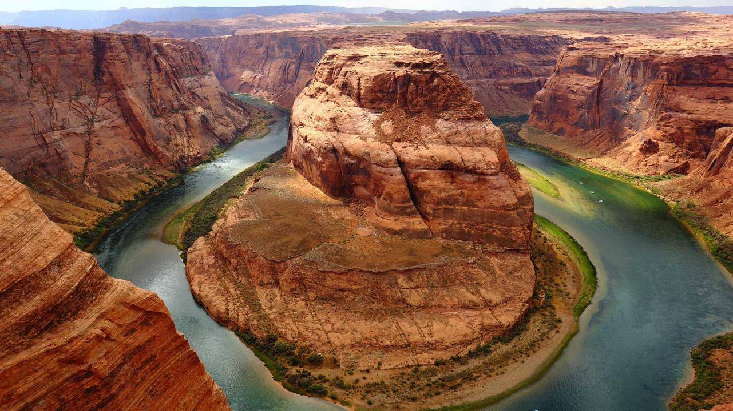
FIELD TRIP TEMPLATE
N
W
E
S
How to design a location based field trip for viewing by other students.
Notes:
A template for students to design a field trip to a location for other students to view. Includes directions to the student of what to include on each slide and what content should be considered.

Slide 2
DIRECTIONS: A good field trip is not just a series of pictures. Make sure you know what the objective of your trip is. What is the idea behind the trip?
Look through the following slides
Each slide has a specific purpose
Use images and videos
Remember to include facts
Do not put lots of words into your presentation
Do use other objects
Maps
Links
Keep your objective in mind as your create your trip
Make sure to create a presentation that will enlighten and entertain your audience.

Slide 3
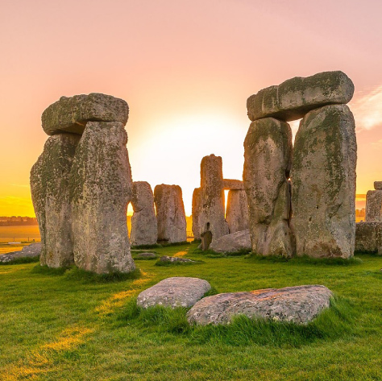
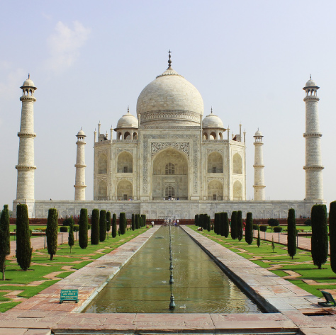
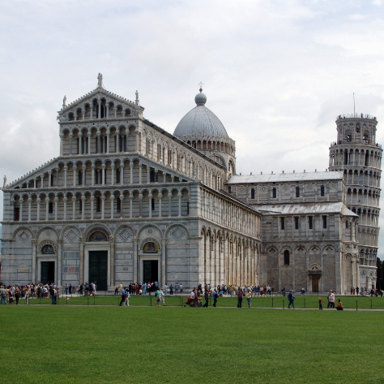
TITLE SLIDE
Use this to announce the destination of today’s trip

Slide 4
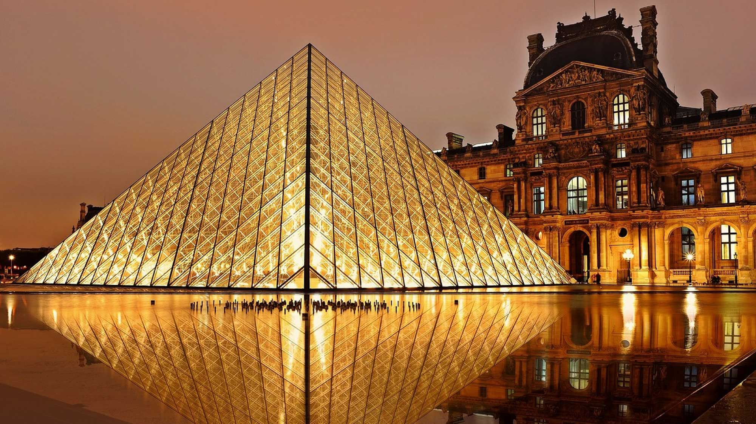
TITLE
Use this blank slide to insert a BIG image of the location for your trip.
This slide should capture your fellow students’ interest.
In the notes area, write a terrific lead into the trip you will be taking people on today.
Notes:
For example, Astoria Oregon is a town on the Oregon coast well know for its starring role in the movie “The Goonies”. Today, we will take a trip from our school to Astoria through miles and time…

Slide 5

1ST IMPORTANT FACT ABOUT YOUR VISIT
Use this slide to add information about an important fact about the place you are visiting virtually.
Create a great bulleted list.
Only put a few words up here so you are not tempted to read from the slide.
You can also include a picture on the slide to add interest.

Slide 6
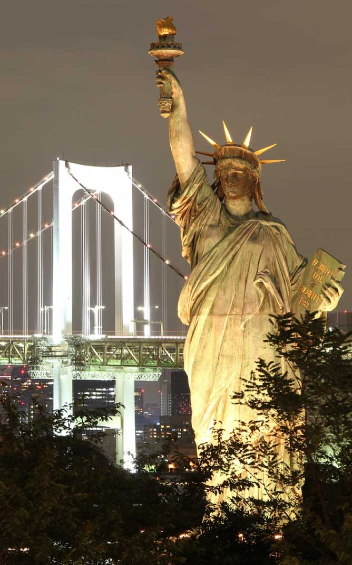
2ND IMPORTANT FACT ABOUT YOUR VISIT
Use this slide to add information about another important fact about the place you are visiting virtually.
Create another great bulleted list.
Only put a few words up here so your not tempted to read from the slide.
You can also include a picture on this slide to add interest.
You can also duplicate this slide to add more important facts about the place you are visiting virtually.

Slide 7
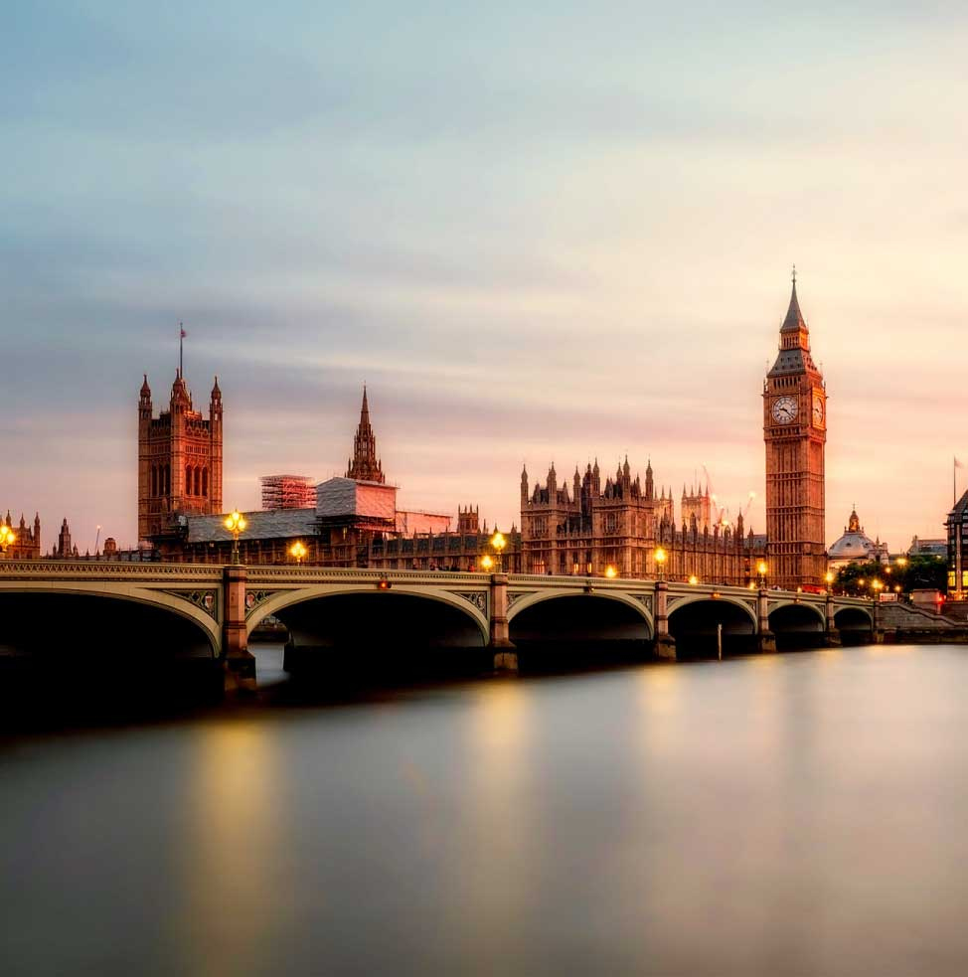
VIDEO
Find a video that brings to life the location that you are visiting virtually.
Add a description of the video here.

Slide 8
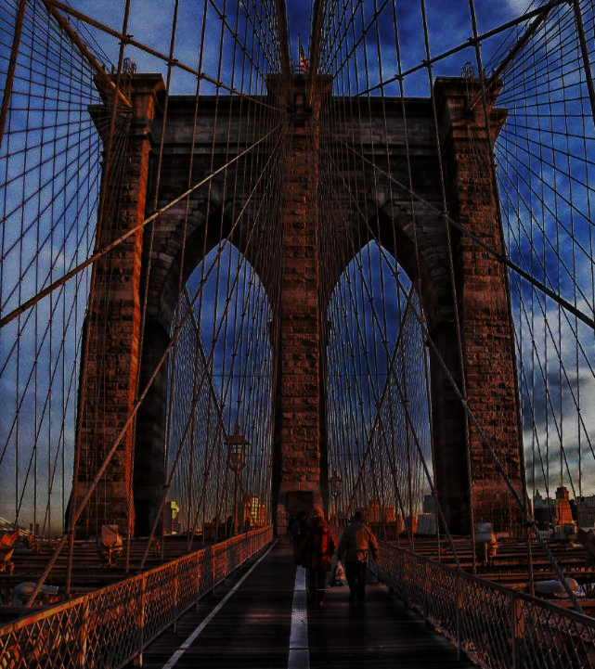
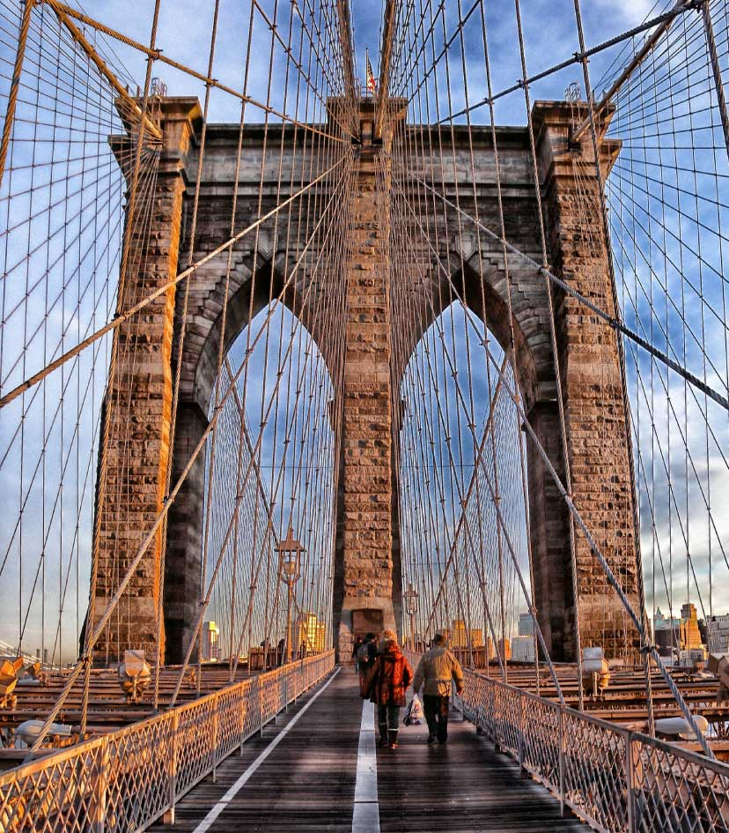
1ST IMPORTANT LOCATION IN YOUR VISIT
Add an image that captures a key part of your virtual field trip.
Provide details about the image.
Notes:
You can use this type of slide for text, images, shapes and tables to help add information in a different way. Duplicate this slide to add additional images of important location in your visit.

Slide 9

2ND IMPORTANT LOCATION IN YOUR VISIT
Add an image that captures a key part of your virtual field trip.
Provide details about the image.
Notes:
You can use this type of slide for text, images, shapes and tables to help add information in a different way. Duplicate this slide to add additional images of important location in your visit.

Slide 10
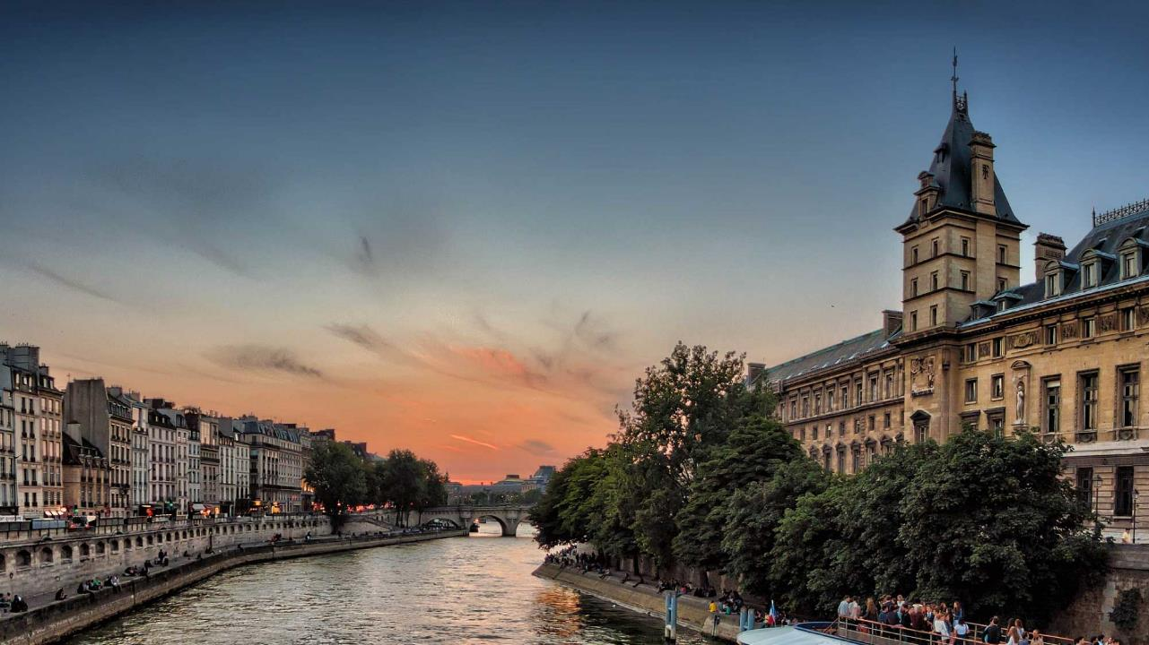
END SLIDE
Wrap up your presentation, last thoughts, contacts for travel, references

Slide 11
Customize this Template
Template Editing Instructions and Feedback

